Slide 1

CPG Brands AD-HOC INSIGHTS
DATA ANALYST SQL PROJECT
CREATED BY SANG LU (SANDRA)

Slide 2
AGENDA
Introduction to Company
Problem Statement
Ad-Hoc Request and Insights

Slide 3
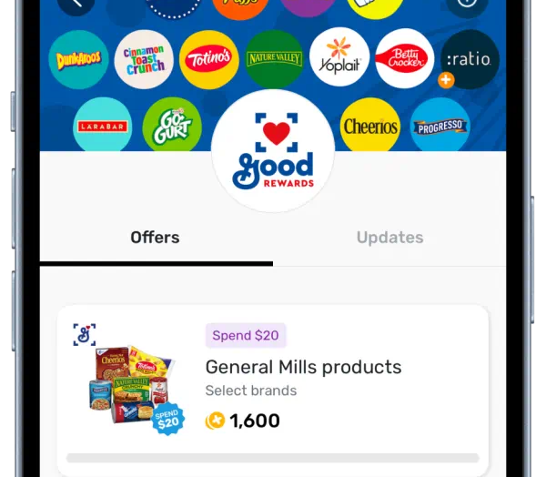

introduction to company
Fetch Rewards is America’s leading consumer-engagement platform that rewards shoppers for buying the brands they love. The Fetch app gives users the easiest way to save on everyday purchases by simply scanning their receipt.
Fetch helps brands activate and engage with America’s consumers through billions of item-level receipts, driving business-changing results for leading CPG brands, retailers and restaurants.
Domain: Consumer Goods

Slide 4
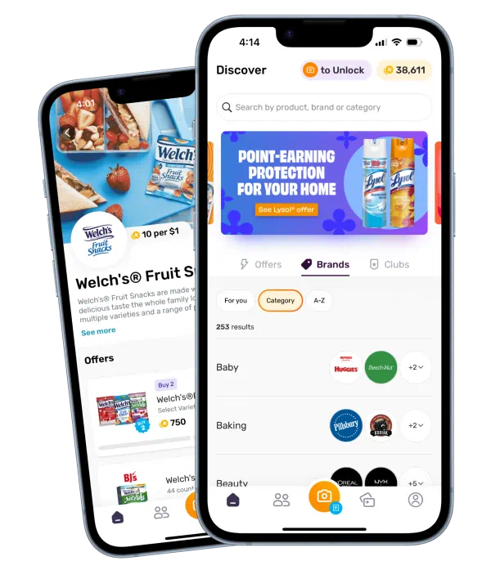
Problem Statement
The problem at hand is to analyze and compare various aspects of brand performance based on receipts scanned and user data. The focus is on understanding the recent month's data and comparing it to the previous month's data. Additionally, we aim to determine the average spend and total number of items purchased for receipts with different reward status. Furthermore, we need to identify the brand with the highest spend and the brand with the most transactions among users created within the past 6 months.
Overall, the problem revolves around analyzing brand performance metrics, such as receipts scanned, average spend, total items purchased, and user behavior within specific timeframes. The objective is to provide insights into brand rankings, user spending patterns, and identify key brand performance indicators based on the available data.

Slide 5
Ad hoc Request and insights
Review unstructured JSON data and diagram a new structured relational data model
Generated a SQL query to answer several business questions
Evaluate data quality issues in the provided data
Present this insight to business stakeholders

Slide 6
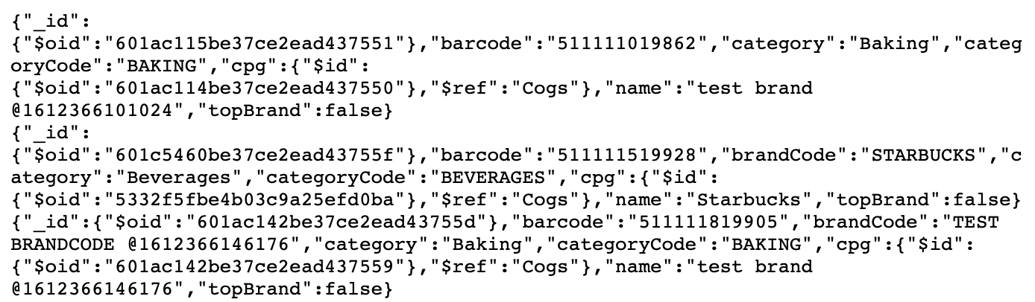

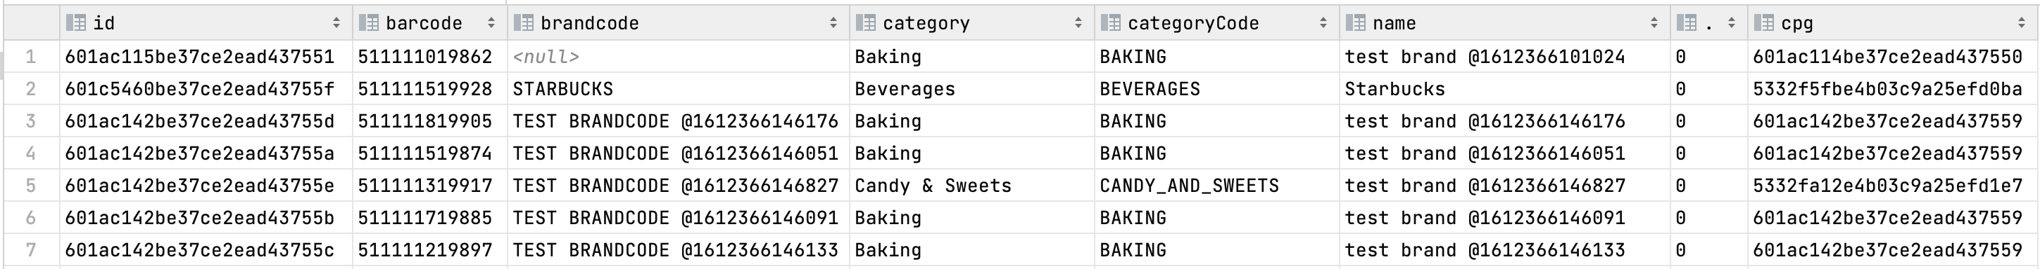
Standardize unstructured data

Slide 7
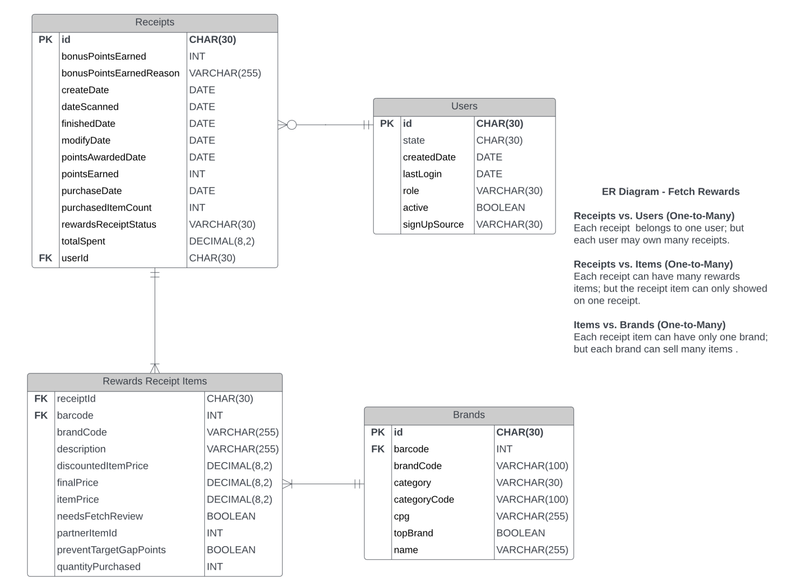
Data model

Slide 8
Questions
what are the top 5 brands by receipts scanned for most recent month?
How does the ranking of the top 5 brands by receipts scanned for the recent month compared to the ranking for the previous month?
When considering average spend from receipts with 'rewardsReceiptStatus’ of ‘Accepted’ or ‘Rejected’, which is greater?
When considering total number of items purchased from receipts with 'rewardsReceiptStatus’ of ‘Accepted’ or ‘Rejected’, which is greater?
Which brand has the most spend among users who were created within the past 6 months?
Which brand has the most transactions among users who were created within the past 6 months?

Slide 9
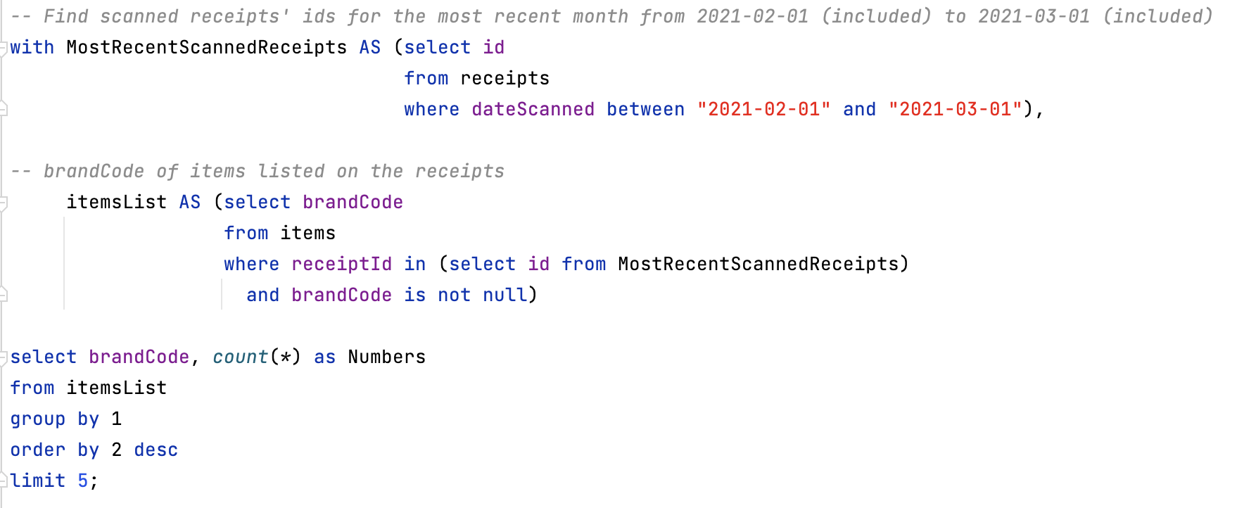
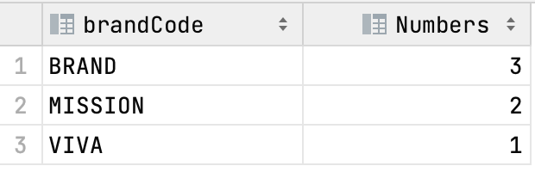
QUESTION 1
What are the top 5 brands by receipts scanned for most recent month?
Output

Slide 10
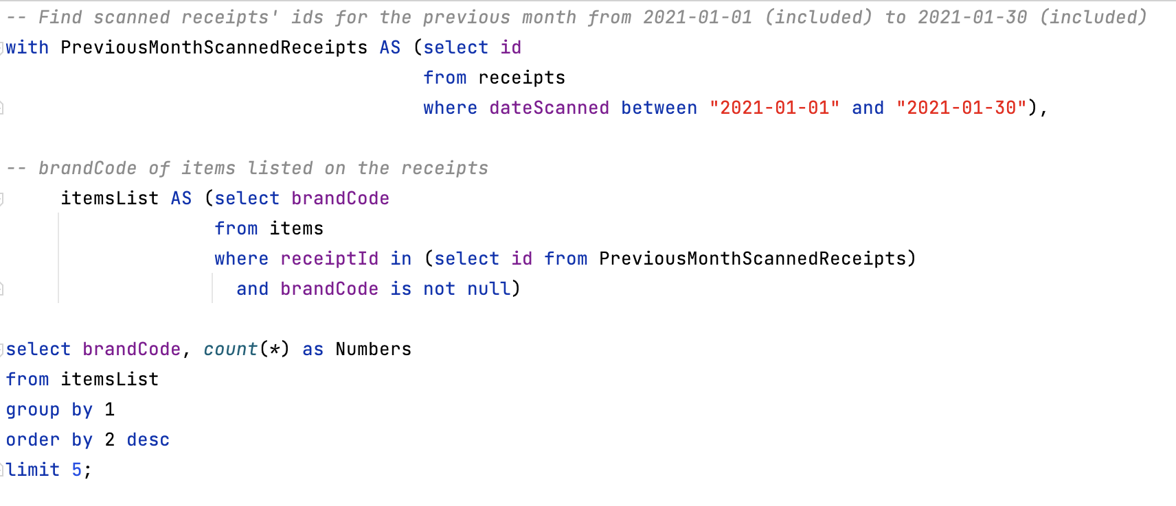
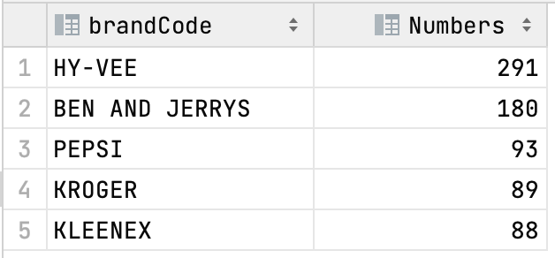
QUESTION 2
How does the ranking of the top 5 brands by receipts scanned for the recent month compared to the ranking for the previous month?
Output

Slide 11
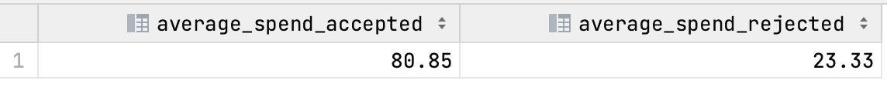
QUESTION 3
When considering average spend from receipts with 'rewardsReceiptStatus’ of ‘Accepted’ or ‘Rejected’, which is greater?
Output

Slide 12
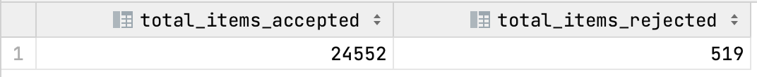
QUESTION 4
When considering total number of items purchased from receipts with 'rewardsReceiptStatus’ of ‘Accepted’ or ‘Rejected’, which is greater?
Output

Slide 13
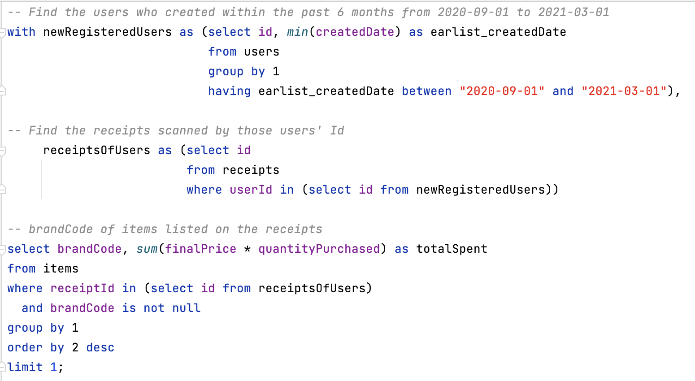
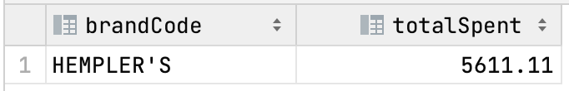
QUESTION 5
Which brand has the most spend among users who were created within the past 6 months?
Output

Slide 14
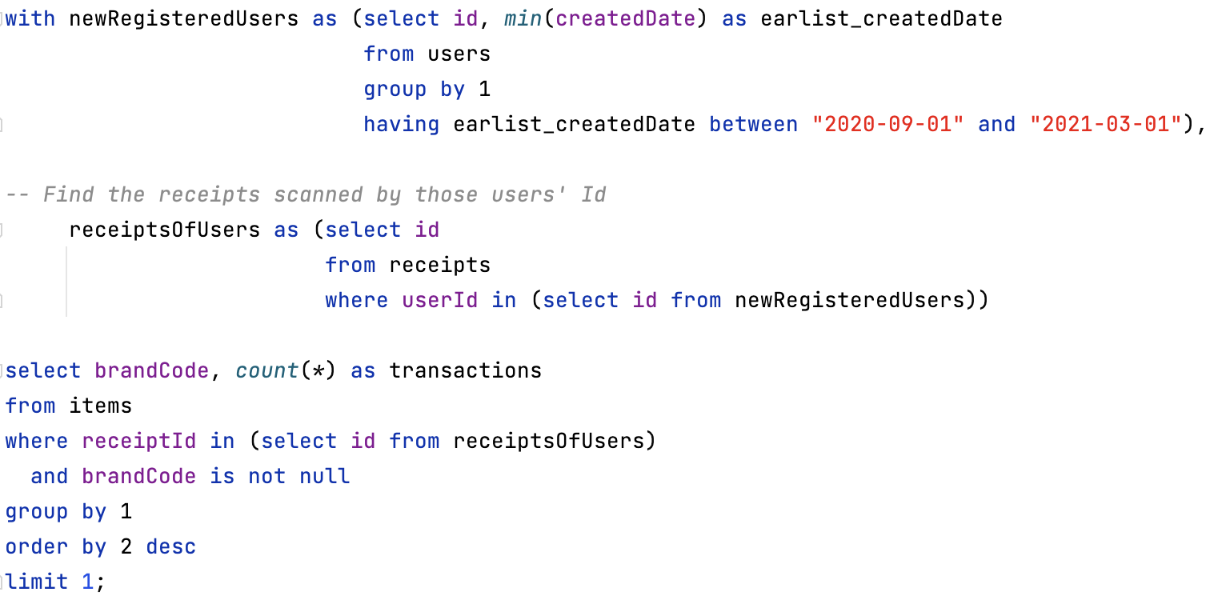
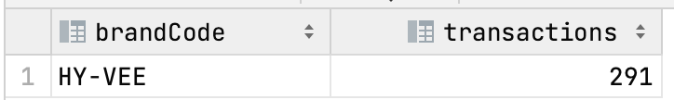
QUESTION 6
Which brand has the most transactions among users who were created within the past 6 months?
Output

Slide 15
Thank you!

